Slide 1
Fourier transform of audio data
By Ridlo Wahyudi Wibowo (20912009)
& Nandia Primasari (20912019)

Slide 2
Discrete Fourier Transform (Introduction)
The discrete Fourier transform (DFT) converts a finite list of equally spaced samples of a function into the list of coefficients of a finite combination of complex sinusoids, ordered by their frequencies, that has those same sample values. It can be said to convert the sampled function from its original domain (often time or position along a line) to the frequency domain.

Slide 3
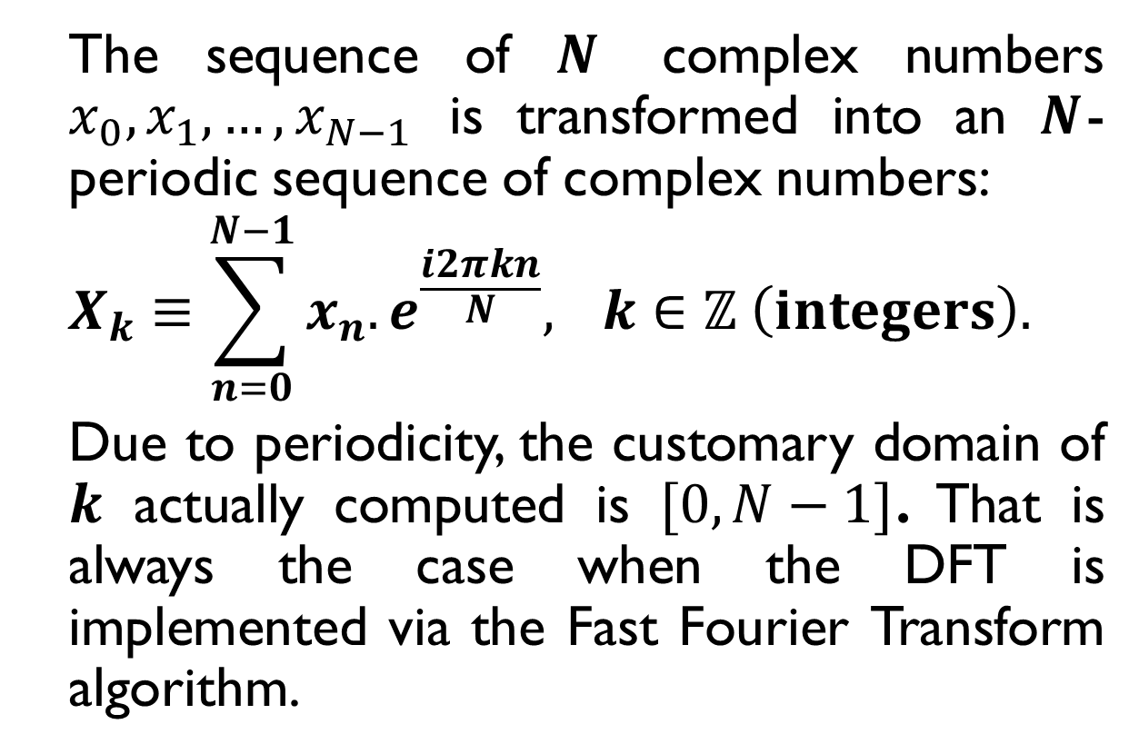
Discrete Fourier Transform (Definition)
The sequence of $N$ complex numbers $x_{0},x_{1},…,x_{N−1}$ is transformed into an $N$-periodic sequence of complex numbers:
$$X_{k}≡\sum_{n=0}^{N−1}{x_{n}.e^{\frac{i2πkn}{N}},} k∈ℤ \left(integers\right).$$
Due to periodicity, the customary domain of $k$ actually computed is $[0, N−1]$. That is always the case when the DFT is implemented via the Fast Fourier Transform algorithm.

Slide 4
The fast fourier tranform
A Fast Fourier Transform (FFT) is an algorithm to compute the discrete Fourier transform (DFT) and its inverse. Fourier analysis convert time (or space) to frequency and vice versa; an FFT rapidly computes such transformation by factorizing the DFT matrix into product of sparse (mostly zero) factors.

Slide 5
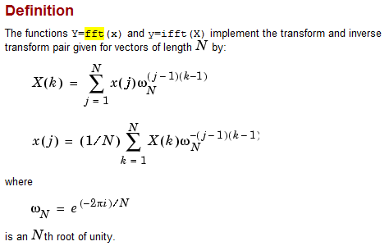
The fast fourier tranform Algorithm (1)

Slide 6
The fast fourier tranform Algorithm (2)
[y,Fs,bits] = wavread(file);
y_fft_origin = fft(y);
y_fft = abs(y_fft_origin);
y_ifft = ifft(y_fft);
y_ifft = real(y_ifft);
wavwrite(y_ifft, Fs, bits, wfile)
operated

Slide 7
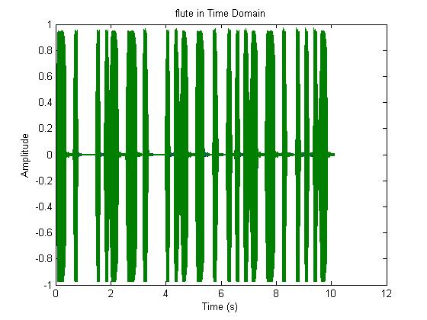
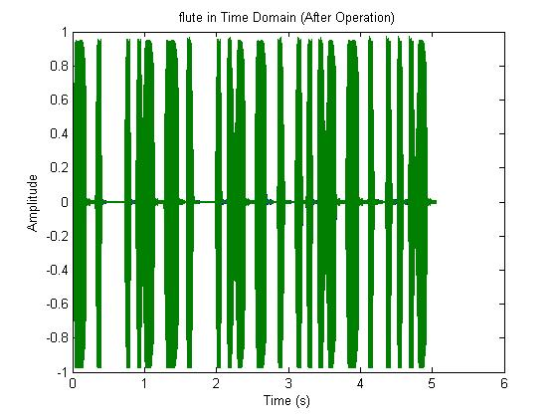
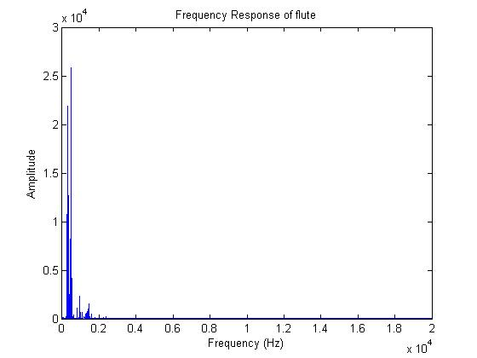
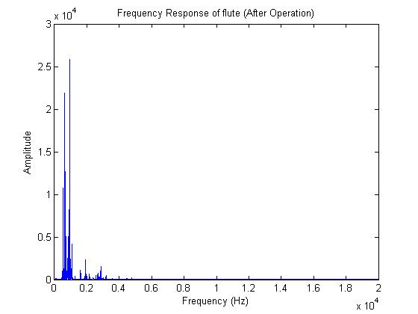
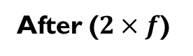
Result 1: Flute
Before
After ($2×f$)

Slide 8
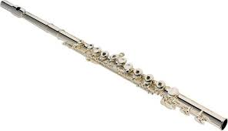

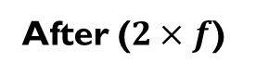
Result 1: Flute
Before
After ($2×f$)

Slide 9
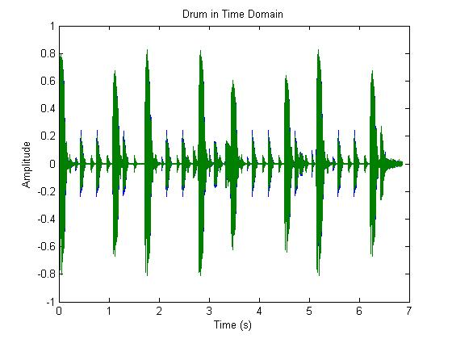
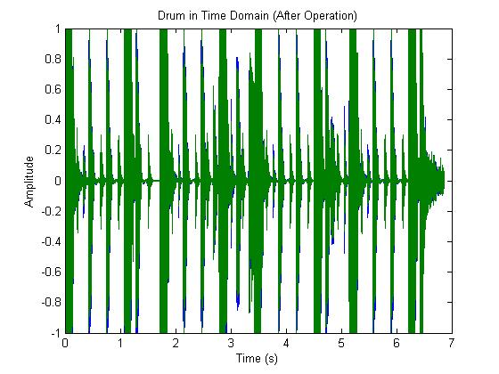
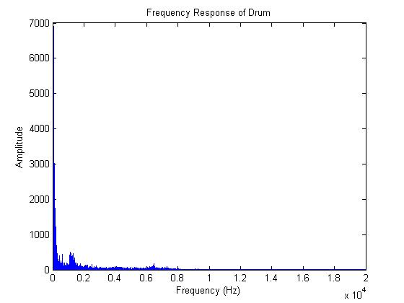
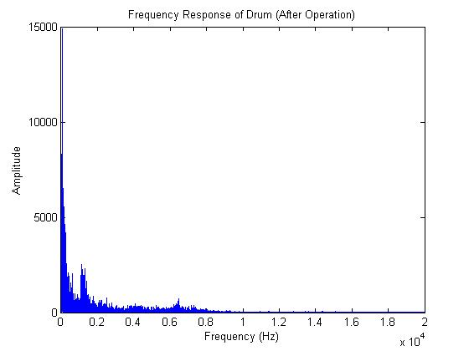
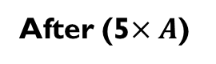
Result 2: Drum
Before
After (5$×A$)

Slide 10

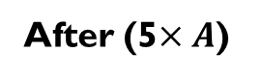
Result 2: Drum
Before
After (5$×A$)

Slide 11
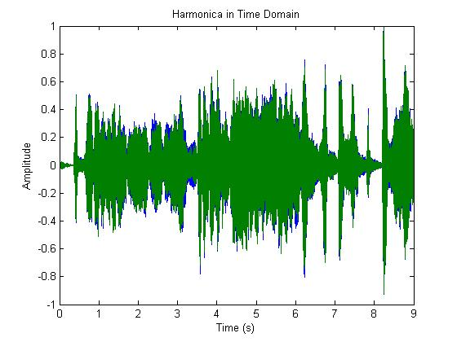
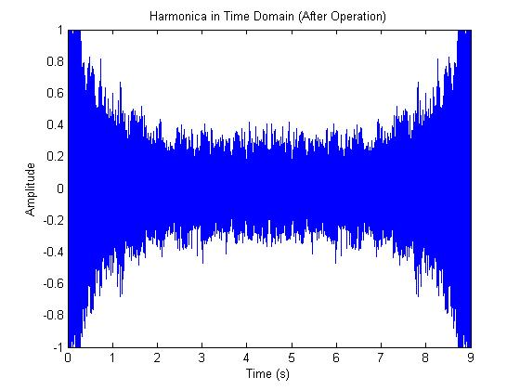
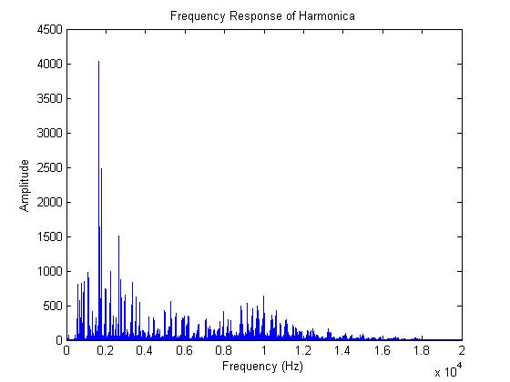
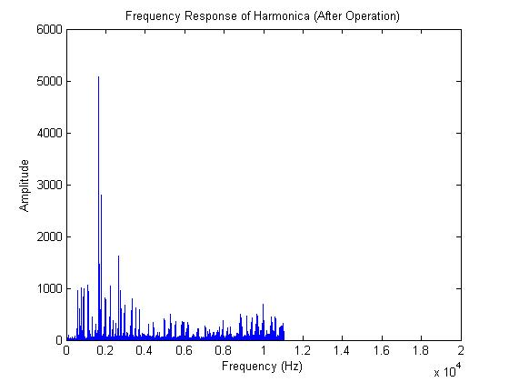
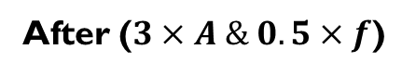
Result 3: Harmonica
Before
After ($3×A \& 0.5×f$)

Slide 12
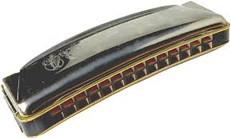
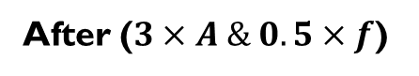
Result 3: Harmonica
Before
After ($3×A \& 0.5×f$)

Slide 13
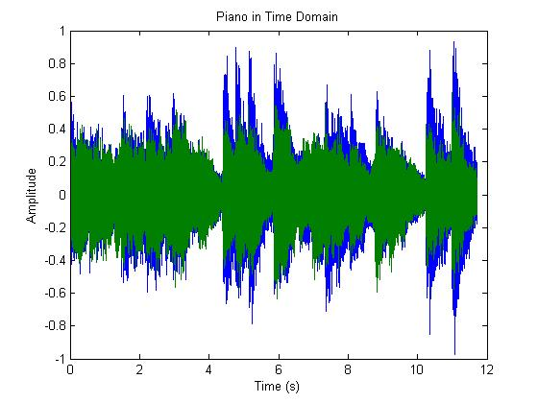
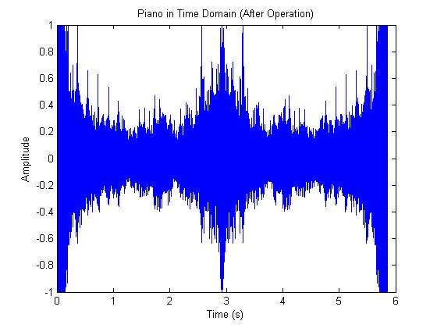
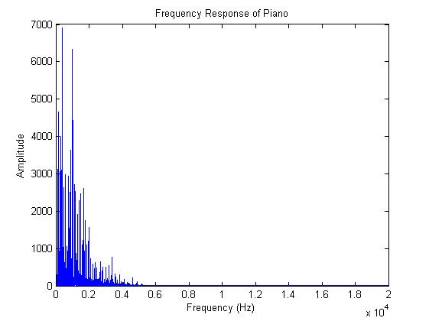
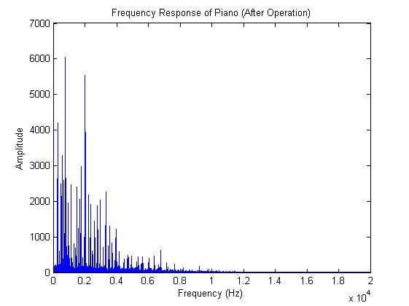
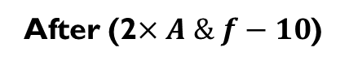
Result 4: Piano
Before
After (2$×A \& f−10$)

Slide 14
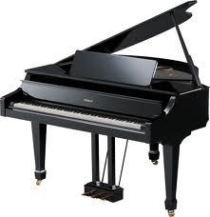
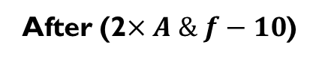
Result 4: Piano
Before
After (2$×A \& f−10$)

